Slide 1
Fortune Cookies Model
BADS#4

Slide 2
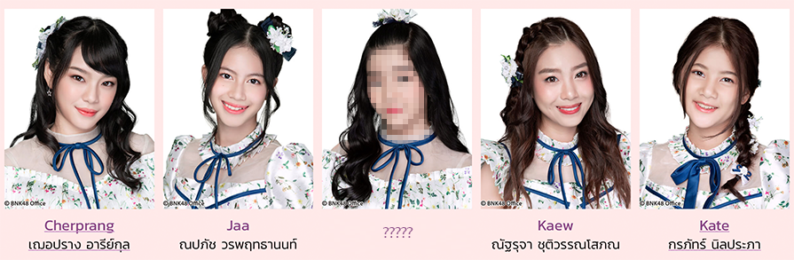






BNK48
Objective
Fortune Cookies Model
Data Collection

Slide 3
BNK48
Fortune Cookies Model

Slide 4
BNK48
Association Rule
Fortune Cookies Model
Cherprang [eye]
Pun [lineament]
Rule 1734
0.116/0.674
Jennis [mouth],
Orn [nose]
0.116 | Jennis [mouth] | Cherprang [eye] | Pun [lineament] | Orn [nose]

Slide 5
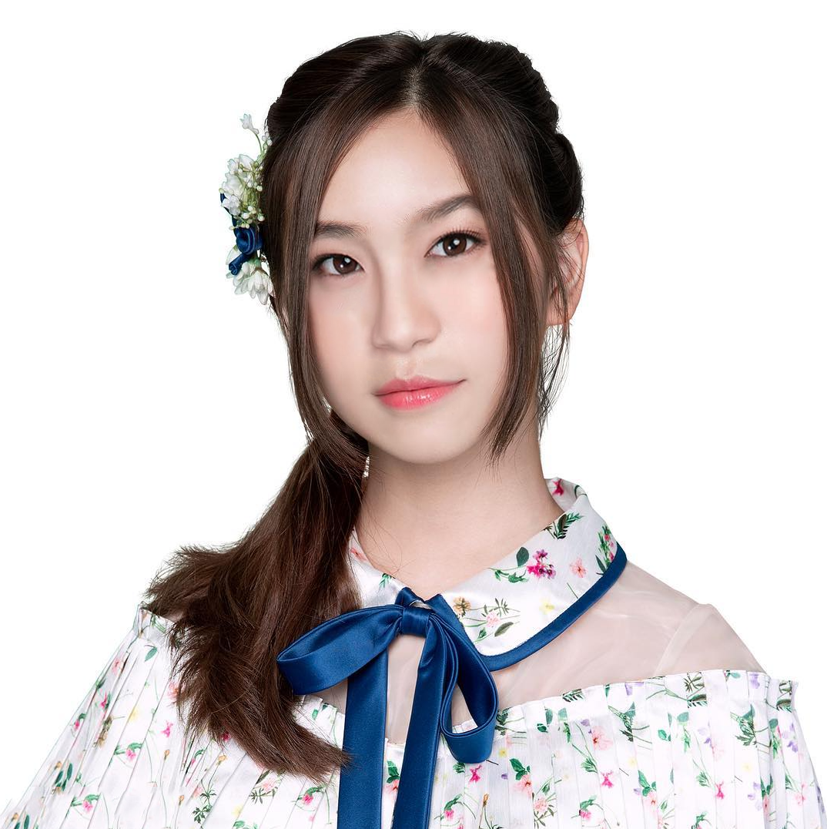

BNK48
Eye (Cherprang)
Fortune Cookies Model
Face (Pun)
Nose (Orn)
Mouse (Jennis)

Slide 6
BNK48
Fortune Cookies Model
0.116 | Jennis [mouth] | Cherprang [eye] | Pun [lineament] | Orn [nose]

Slide 7
BNK48
Fortune Cookies Model

